Slide 1
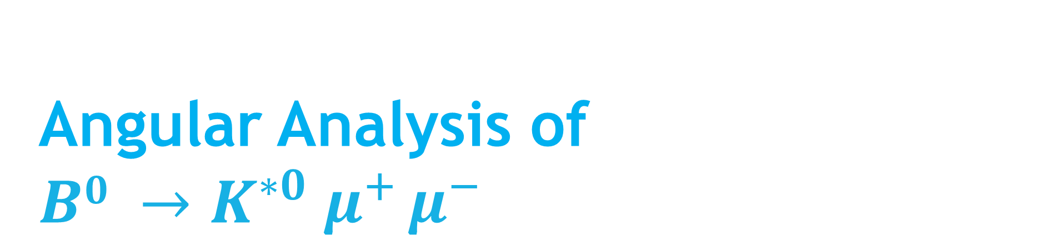
Angular Analysis of $B0 →K^{∗0} μ^{+} μ^{−}$
TBPS: Group 9

Slide 2
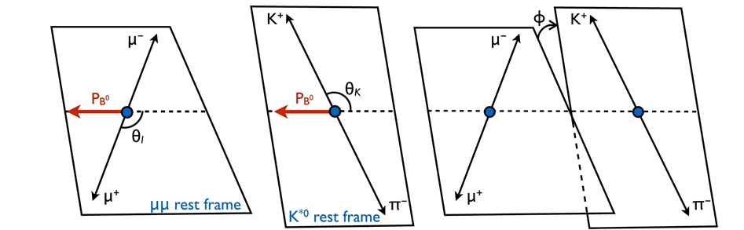
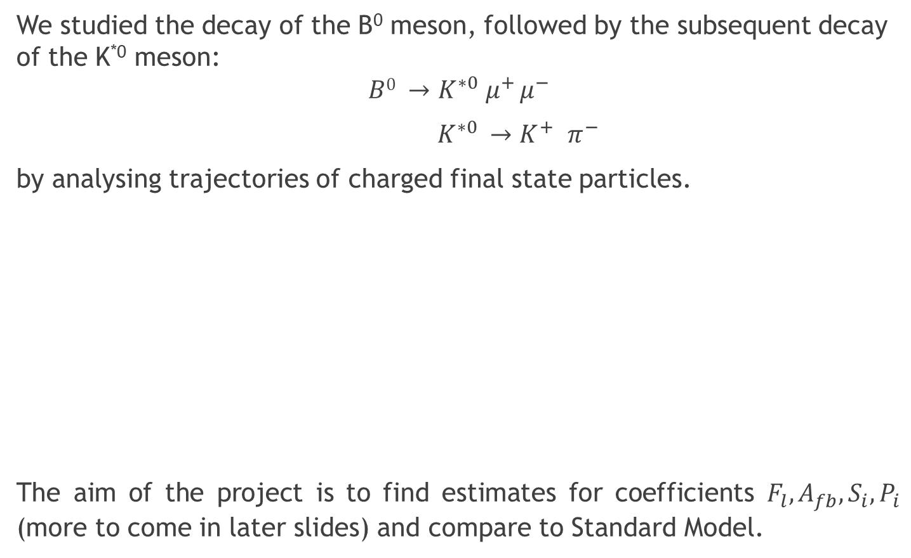
The B⁰ Meson Decay
We studied the decay of the B⁰ meson, followed by the subsequent decay of the K^{*0} meson:
$$B0 →K^{∗0} μ^{+} μ^{−}$$
$K^{∗0} {→K}^{+} π^{−}$
by analysing trajectories of charged final state particles.
The aim of the project is to find estimates for coefficients $F_{l}, A_{fb}, S_{i},P_{i}$ (more to come in later slides) and compare to Standard Model.

Slide 3
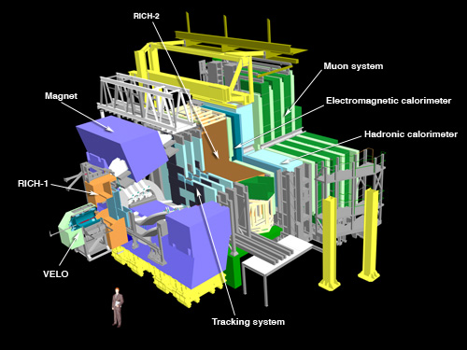
LHCb and B⁰ Meson Decay
Cern, LHCb experiment, http://lhcb-public.web.cern.ch/en/Detector/Detector-en.html

Slide 4


Project Outline
Initially we formed 2 subgroups: research and programming.
In Week 2, researchers and programmers split into 4 subgroups:
Classification
Separate “our” decay events from background, including competing decay channels and $Λ^{0}$ decay
Acceptance
Fit a polynomial in $cos θ_{l},\cos{θ_{k}},φ$ accounting for experimental interference
Fitting
Fit classified data to theoretical distributions to extract optimised parameters
Uncertainties
Investigate sources of uncertainties, estimate and propagate them through tasks

Slide 5
Classification

Slide 6
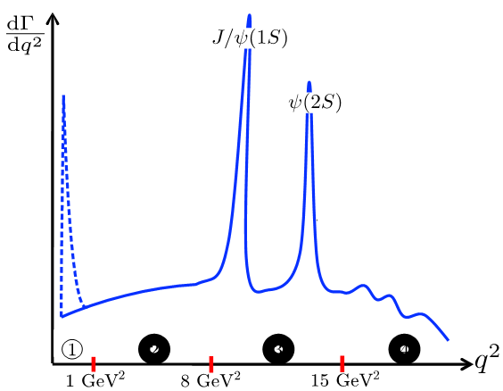
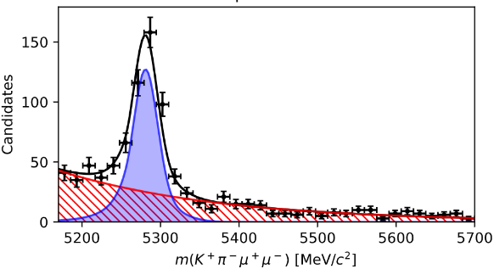
What are the backgrounds?
Peaking
Combinatorial
Reproduced from [Kress, 2020].
Removed in classification:
hard cuts + decision tree
Remove by fitting Crystal Ball function
Notes:
two types of backgrounds
combinatorial: random particles from different decays that happen to appear to look like a signal
peaking: from other decay channels different from the desired signal
cannot remove combinatorial directly as there is not one way to distinguish whether a single decay is a true or fake decay
can remove peaking → we know properties of the signal decay and simulations

Slide 7
Peaking Classification
Step 2: Ensemble Decision Trees
Step 1: Hard Cuts
Notes:
we use a combined method to classify the data
hard cuts are good for roughly getting rid of peaking backgrounds and enforcing basic assumptions on the B0 decay
decision tree is able to be more precise and target specific properties of decays to remove
we explain both methods below

Slide 8
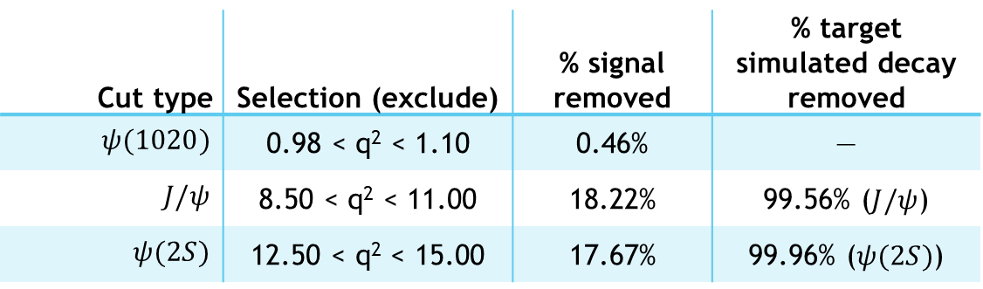
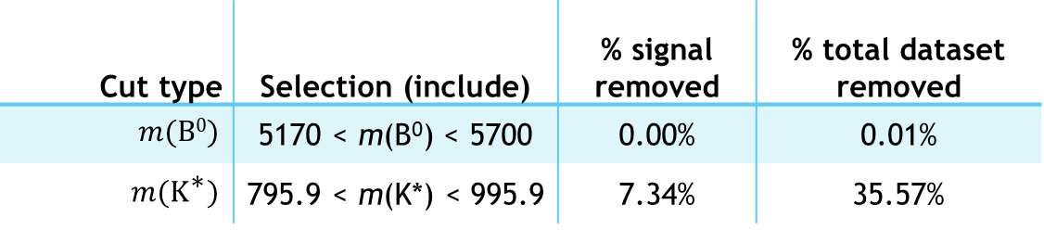
Step 1a: Hard cuts (pre-selection mass)
Cut type | Selection (exclude) | % signal removed | % target simulated decay removed
$ψ(1020)$ | 0.98 < q² < 1.10 | 0.46% | —
$$J/ψ$$ | 8.50 < q² < 11.00 | 18.22% | 99.56% ($J/ψ$)
$$ψ(2S)$$ | 12.50 < q² < 15.00 | 17.67% | 99.96% ($ψ(2S)$)
q²
[GeV²/c⁴]
Cut type | Selection (include) | % signal removed | % total dataset removed
$m\text{(}\text{B}\text{0}\text{)}$ | 5170 < m(B⁰) < 5700 | 0.00% | 0.01%
$$m\text{(}{\text{K}}^{\text{∗}}\text{)}$$ | 795.9 < m(K*) < 995.9 | 7.34% | 35.57%
Invariant mass [MeV/c²]
Notes:
We started by considering each one of the 80 dataset variables
guided by literature and box-whisker plots, we isolate the variables that most distinguish between signal and background
for example, these plots a selection of the probabilities given by the mass hypothesis ML algorithm
these probabilities are able to distinguish between different decays

Slide 9
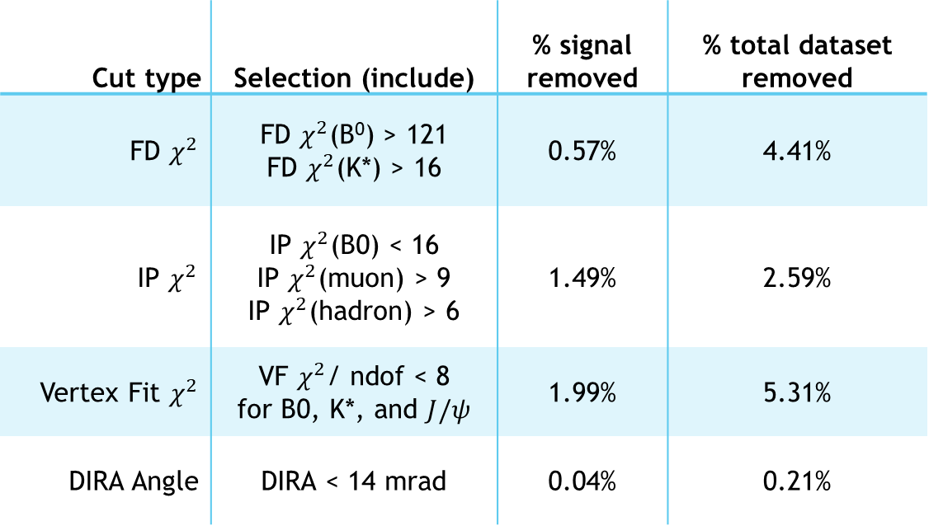
Step 1b: Hard cuts (pre-selection vertex)
flight distance (FD)
Momentum vector
B⁰
DIRA angle
p⁺
Flight vector
impact
parameter (IP)
B⁰
origin
p⁺
Cut type | Selection (include) | % signal removed | % total dataset removed
FD $χ^{2}$ | $\text{FD} χ^{2}$(B⁰) > 121 FD $χ^{2}$(K*) > 16 | 0.57% | 4.41%
$$\text{IP} χ^{2}$$ | $\text{IP} χ^{2}$(B0) < 16 $\text{IP} χ^{2}$(muon) > 9 $\text{IP} χ^{2}$(hadron) > 6 | 1.49% | 2.59%
Vertex Fit $χ^{2}$ | VF $χ^{2}$/ ndof < 8 for B0, K*, and $J/ψ$ | 1.99% | 5.31%
DIRA Angle | DIRA < 14 mrad | 0.04% | 0.21%
Notes:
We started by considering each one of the 80 dataset variables
guided by literature and box-whisker plots, we isolate the variables that most distinguish between signal and background
for example, these plots a selection of the probabilities given by the mass hypothesis ML algorithm
these probabilities are able to distinguish between different decays

Slide 10
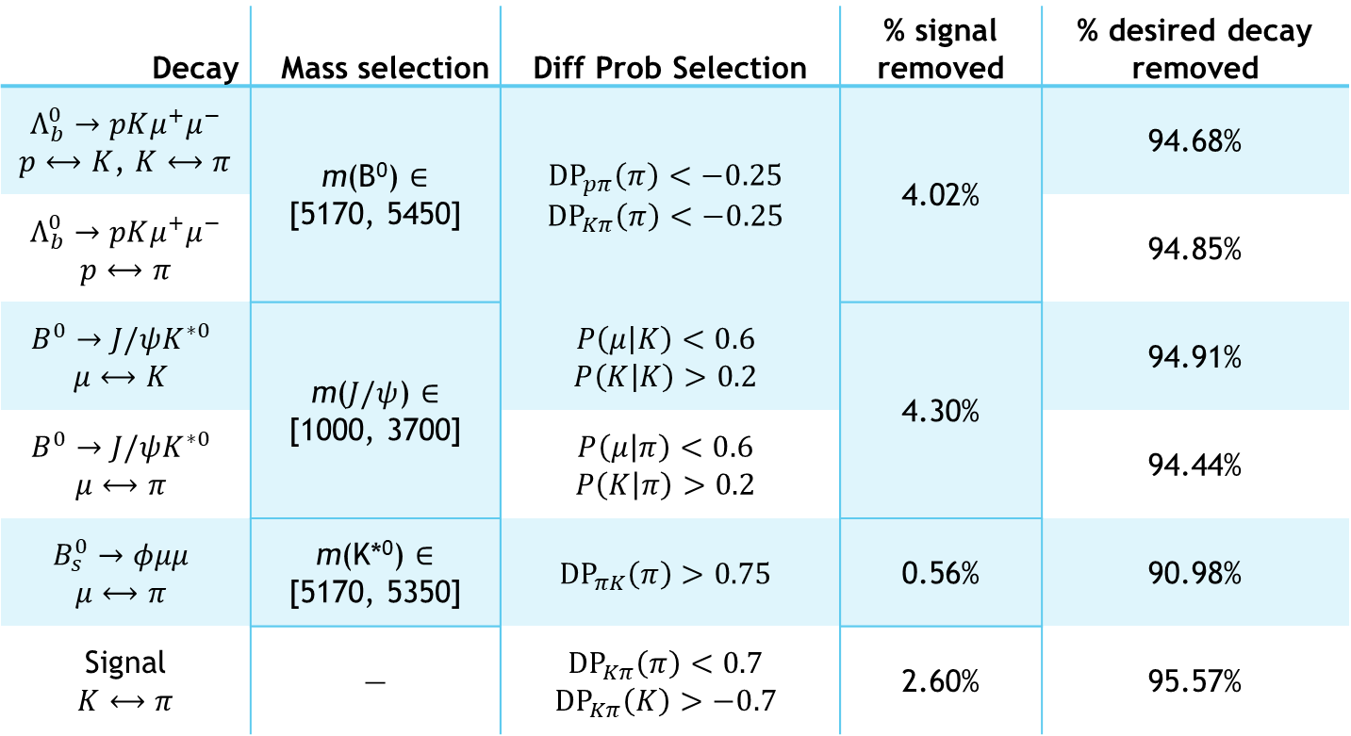
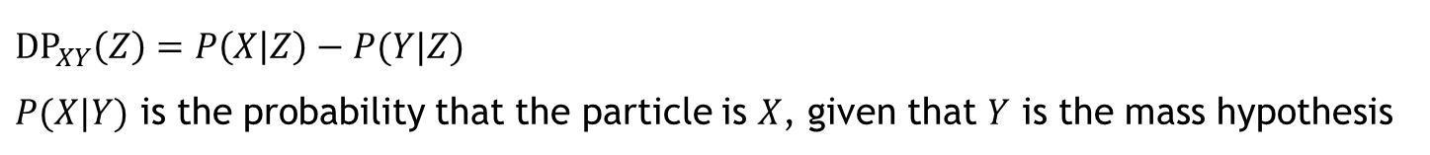
Step 1c: Targeted cuts
Decay | Mass selection | Diff Prob Selection | % signal removed | % desired decay removed
$Λ_{b}^{0}→pKμ^{+}μ^{−}$ $p⟷K$, $K⟷π$ | m(B⁰) $∈$ [5170, 5450] | $${\text{DP}}_{pπ}\left(π\right)<−0.25$$ $${\text{DP}}_{Kπ}\left(π\right)<−0.25$$ | 4.02% | 94.68%
$Λ_{b}^{0}→pKμ^{+}μ^{−}$ $$p⟷π$$ | $$\text{IP} χ^{2}$$ |  | 1.49% | 94.85%
$$B^{0}→J/ψK^{∗0}$$ $$μ⟷K$$ | m($J/ψ$) $∈$ [1000, 3700] | $$P\left(μ | K\right)<0.6$$ $$P\left(K | K\right)>0.2$$ | 4.30% | 94.91%
$$B^{0}→J/ψK^{∗0}$$ $$μ⟷π$$ |  | $$P\left(μ | π\right)<0.6$$ $$P\left(K | π\right)>0.2$$ |  | 94.44%
$$B_{s}^{0}→φμμ$$ $$μ⟷π$$ | m(K*⁰) $∈$ [5170, 5350] | $${\text{DP}}_{πK}\left(π\right)>0.75$$ | 0.56% | 90.98%
Signal $$K⟷π$$ | — | $${\text{DP}}_{Kπ}\left(π\right)<0.7$$ $${\text{DP}}_{Kπ}\left(K\right)>−0.7$$ | 2.60% | 95.57%
${\text{DP}}_{XY}\left(Z\right)=P\left(X | Z\right)−P(Y|Z)$
$P(X|Y)$ is the probability that the particle is $X$, given that $Y$ is the mass hypothesis
Notes:
We started by considering each one of the 80 dataset variables
guided by literature and box-whisker plots, we isolate the variables that most distinguish between signal and background
for example, these plots a selection of the probabilities given by the mass hypothesis ML algorithm
these probabilities are able to distinguish between different decays

Slide 11
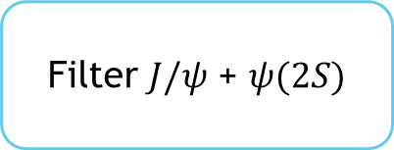
Step 2: Decision Tree
Labeled simulation dataset
Filter $J/ψ$ + $ψ(2S)$
Calculate DLL and total/transverse momentum for B⁰
Gradient Boosted Decision Tree
scikit-learn
HistGradientBoostingClassifier
Keep only relevant columns (not correlated with angular variables or q2)
DLL
B0 (chi2 IP, DIRA angle, total momentum, transverse momentum)
K-Fold validation
see variance between runs
Classify total_dataset and save results
Notes:
Labeled helped remove Jpsi Psi 2s
Add additional labels- difference log likelihood
Give decision tree specific paramaters
GBDT works better for large datasets
See variance in classification power

Slide 12
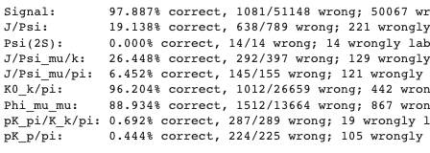
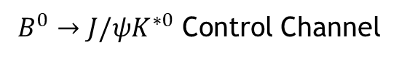
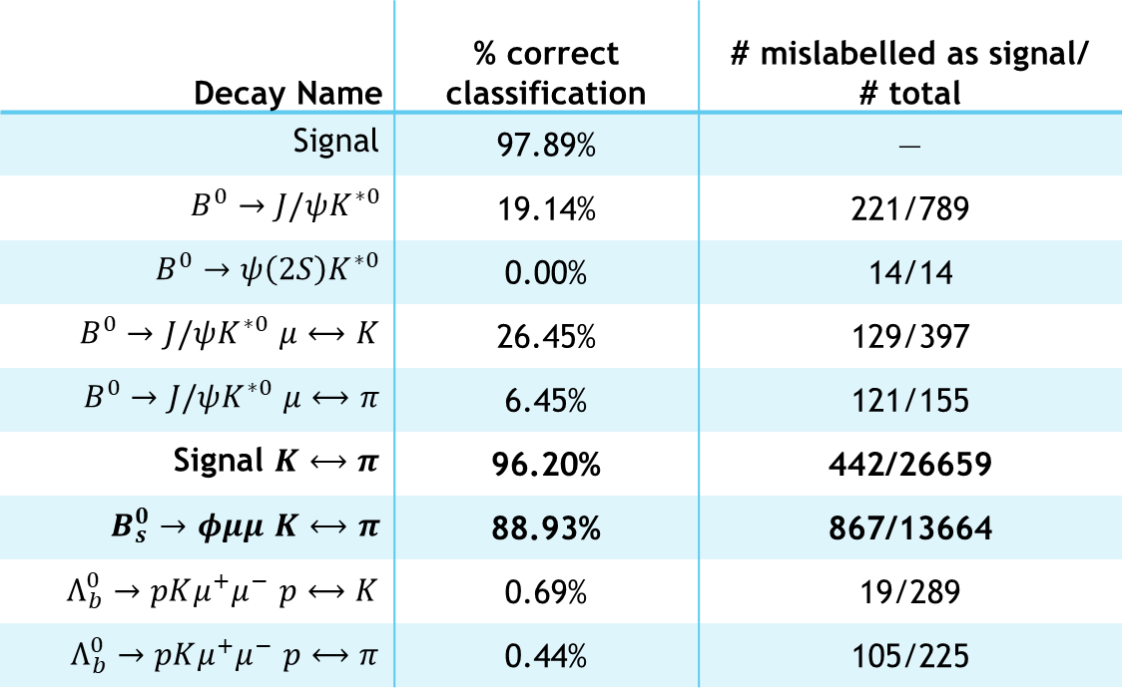
Results of Decision Tree
Total accuracy: 94.53 ± 0.11%
Decay Name | % correct classification | # mislabelled as signal/ # total
Signal | 97.89% | —
$B^{0}→J/ψK^{∗0}$ | 19.14% | 221/789
$B^{0}→ψ\left(2S\right)K^{∗0}$ | 0.00% | 14/14
$B^{0}→J/ψK^{∗0}$ $μ⟷K$ | 26.45% | 129/397
$B^{0}→J/ψK^{∗0}$ $μ⟷π$ | 6.45% | 121/155
Signal $K⟷π$ | 96.20% | 442/26659
$B_{s}^{0}→φμμ$ $K⟷π$ | 88.93% | 867/13664
$Λ_{b}^{0}→pKμ^{+}μ^{−}$ $p⟷K$ | 0.69% | 19/289
$Λ_{b}^{0}→pKμ^{+}μ^{−}$ $p⟷π$ | 0.44% | 105/225
`
$B^{0}→J/ψK^{∗0}$ Control Channel
Removes
background
Notes:
K_0k pi swap very effective
Phi mu mu

Slide 13
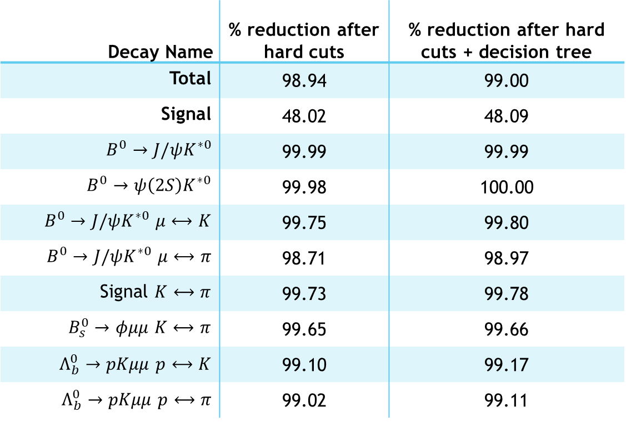
Combined Results
Decay Name | % reduction after hard cuts | % reduction after hard cuts + decision tree
Total | 98.94 | 99.00
Signal | 48.02 | 48.09
$B^{0}→J/ψK^{∗0}$ | 99.99 | 99.99
$B^{0}→ψ\left(2S\right)K^{∗0}$ | 99.98 | 100.00
$B^{0}→J/ψK^{∗0}$ $μ⟷K$ | 99.75 | 99.80
$B^{0}→J/ψK^{∗0}$ $μ⟷π$ | 98.71 | 98.97
Signal $K⟷π$ | 99.73 | 99.78
$B_{s}^{0}→φμμ$ $K⟷π$ | 99.65 | 99.66
$Λ_{b}^{0}→pKμμ$ $p⟷K$ | 99.10 | 99.17
$Λ_{b}^{0}→pKμμ$ $p⟷π$ | 99.02 | 99.11
Total dataset:
Reduced from 498245 to 4973 samples
Notes:
After hard cuts, remove undesured decay to about half signal
After dt phi mu mu
Half a mil to 5000 decays

Slide 14
Combined Results
Total
Dataset
After hard cut
+ decision tree
Signal
Dataset

Slide 15
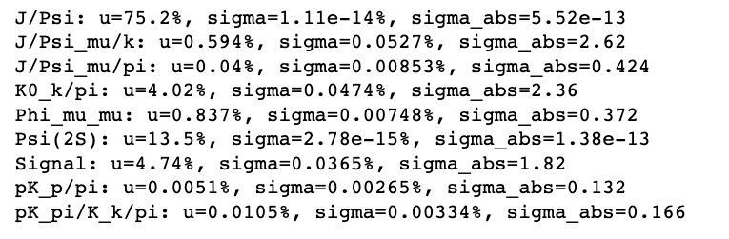
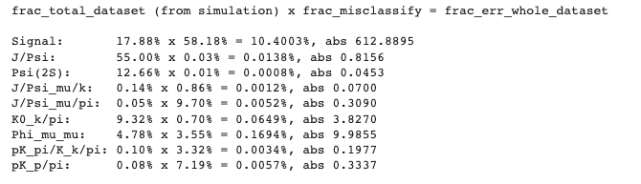
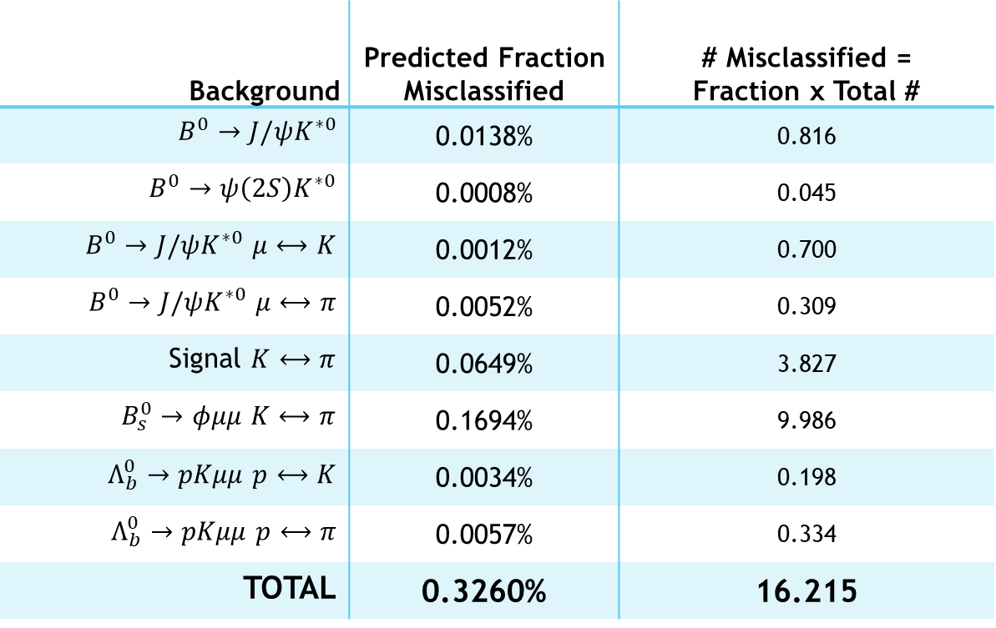
Expected Fraction Misclassification
$$P\left(\text{misclassified}\text{|}\text{decay}\right)×P(\text{decay}|\text{total} \text{dataset})=P\left(\text{misclassif}\text{ied} | \text{total} \text{dataset}\right)$$
Background | Predicted Fraction Misclassified | # Misclassified = Fraction x Total #
$B^{0}→J/ψK^{∗0}$ | 0.0138% | 0.816
$B^{0}→ψ\left(2S\right)K^{∗0}$ | 0.0008% | 0.045
$B^{0}→J/ψK^{∗0}$ $μ⟷K$ | 0.0012% | 0.700
$B^{0}→J/ψK^{∗0}$ $μ⟷π$ | 0.0052% | 0.309
Signal $K⟷π$ | 0.0649% | 3.827
$B_{s}^{0}→φμμ$ $K⟷π$ | 0.1694% | 9.986
$Λ_{b}^{0}→pKμμ$ $p⟷K$ | 0.0034% | 0.198
$Λ_{b}^{0}→pKμμ$ $p⟷π$ | 0.0057% | 0.334
TOTAL | 0.3260% | 16.215
Result | Fractional Error (%) | Absolute Error
J/Psi | 0.0138 | 0.8156
Psi (2S) | 0.0008 | 0.0453
J/Psi_mu/k | 0.0012 | 0.700
J/Psi_mu/pi | 0.0052 | 0.3090
K0_k/pi | 0.0649 | 3.8270
Phi_mu_mu | 0.1694 | 9.9855
pK_pi/K_k/pi | 0.0034 | 0.1977
pK_p/pi | 0.0057 | 0.3337
Notes:
Estimate number of misclassified data points
From cuts, apply on to simulated datasets from each decay
How many decays selection criteria miss
Gives estimate of background decays that won’t get picked up
Main result: aphi mu mu worst performing, still comparatively small therefore

Slide 16

$B^{0}$ Invariant
Mass Model

Slide 17
Q: Why fit to the invariant mass?
A: We fit to the invariant mass distribution to differentiate background from signal candidates.
Notes:
In the classification, we don’t want to remove all background if we also end up removing a significant portion of the signal.
Instead, we can observe the remaining background from the signal (post classification) on the invariant mass distribution – non-signal events won’t show up as crystal ball functions, but take a different form
➔ From invariant mass can work out the fraction of signal events to background $f_{sig}$

Slide 18
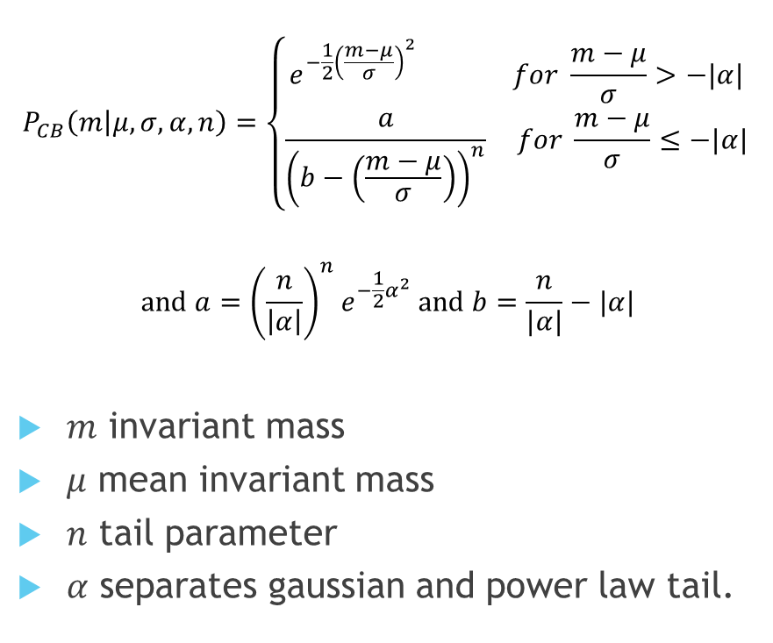
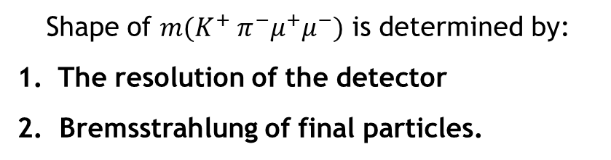
The ‘crystal ball’ function PDF
$$P_{CB}\left(m | μ, σ, α, n\right)=\left\{\begin{aligned}e^{−\frac{1}{2}{\left(\frac{m−μ}{σ}\right)}^{2}} for \frac{m−μ}{σ}>−|α| \\ \frac{a}{{\left(b−\left(\frac{m−μ}{σ}\right)\right)}^{n}} for \frac{m−μ}{σ}≤−|α|\end{aligned}\right.$$
$$and a={\left(\frac{n}{\left|α\right|}\right)}^{n}e^{−\frac{1}{2}α^{2}} and b=\frac{n}{|α|}−|α|$$
$m$ invariant mass
$μ$ mean invariant mass
$n$ tail parameter
$α$ separates gaussian and power law tail.
Shape of $m(K^{+} π^{−}μ^{+}μ^{−})$ is determined by:
The resolution of the detector
2. Bremsstrahlung of final particles.
Gaussian peak
Power-law tail

Slide 19
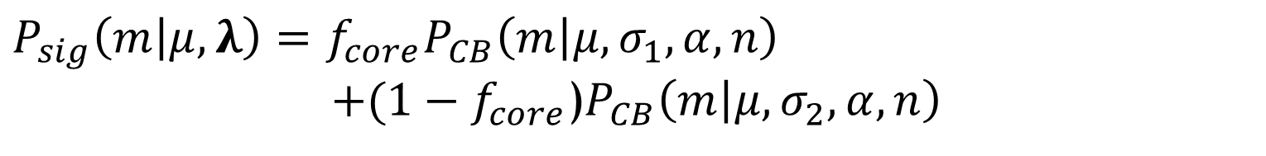
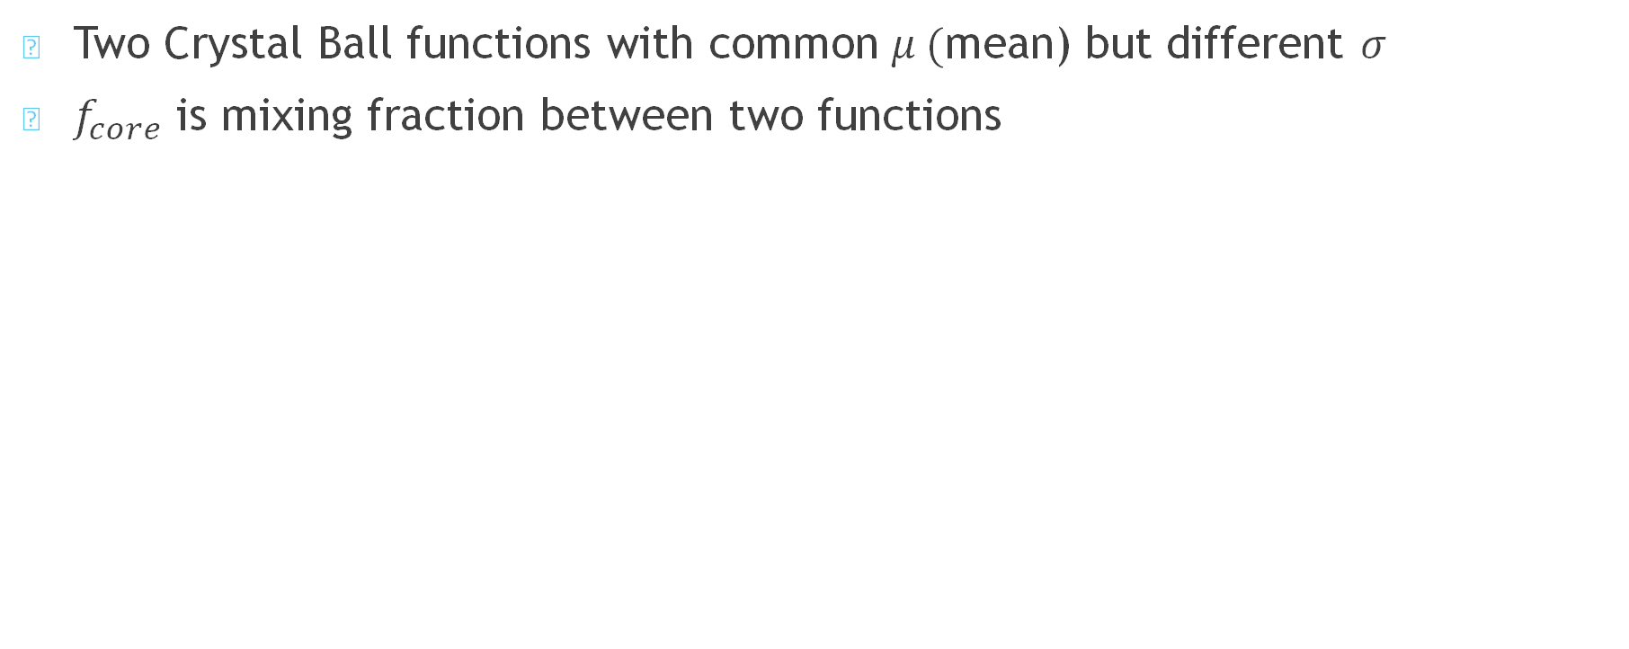
Two Crystal Ball functions…
Two Crystal Ball functions with common $μ ($mean) but different $σ$
$f_{core}$ is mixing fraction between two functions
$P_{sig}\left(m | μ, λ\right)=$ ${f_{core}P}_{CB}\left(m | μ,σ_{1}, α, n\right)$
$+(1−f_{core}$)$P_{CB}\left(m | μ, σ_{2}, α, n\right)$

Slide 20
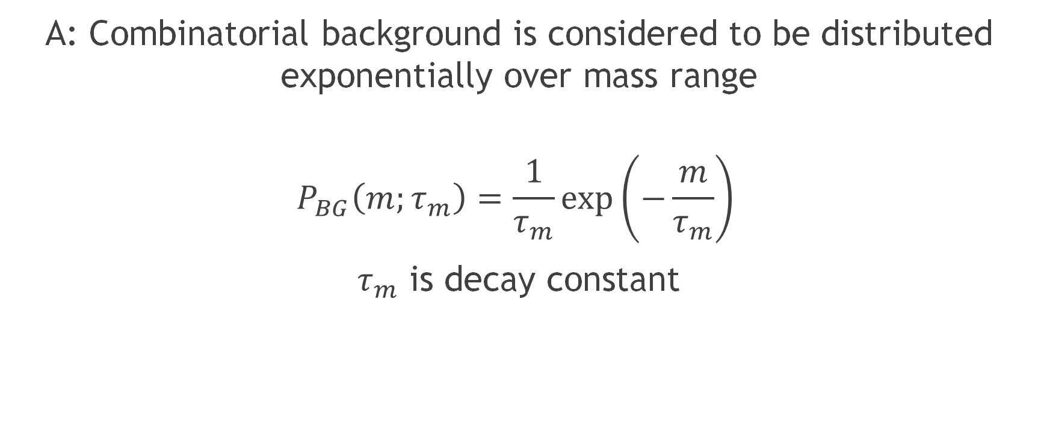
Q: What does the invariant mass of the background look like?
A: Combinatorial background is considered to be distributed exponentially over mass range
$$P_{BG}\left(m;τ_{m}\right)=\frac{1}{τ_{m}}\exp\left(−\frac{m}{τ_{m}}\right)$$
$τ_{m}$ is decay constant

Slide 21
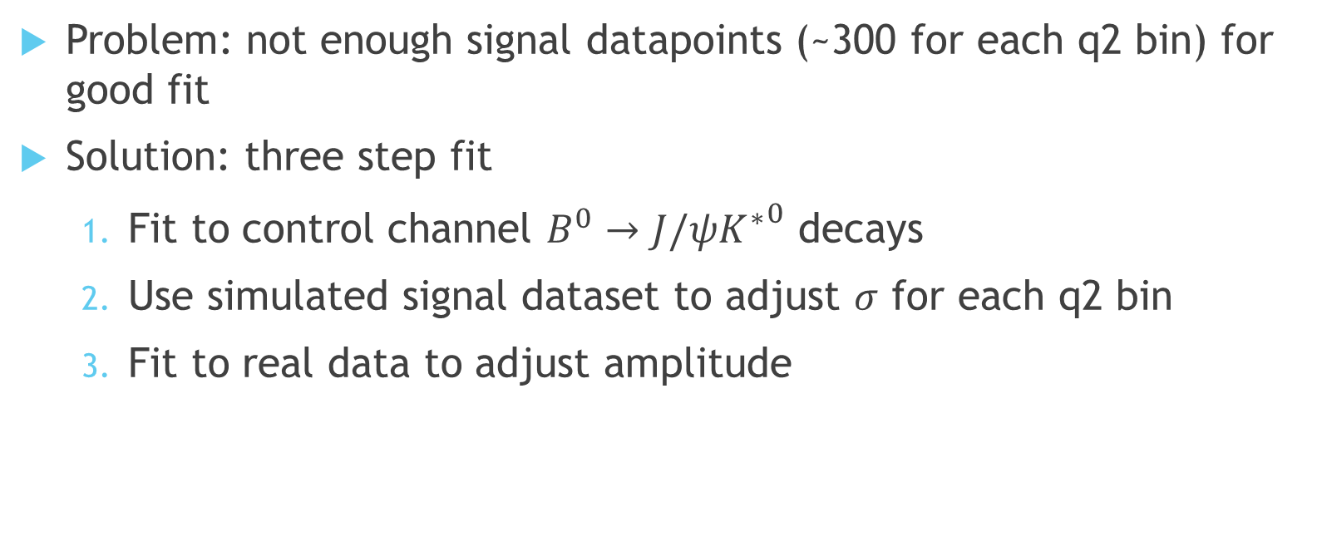
Fitting Method
Problem: not enough signal datapoints (~300 for each q2 bin) for good fit
Solution: three step fit
Fit to control channel $B^{0}→J/ψ{K^{∗}}^{0}$ decays
Use simulated signal dataset to adjust $σ$ for each q2 bin
Fit to real data to adjust amplitude

Slide 22
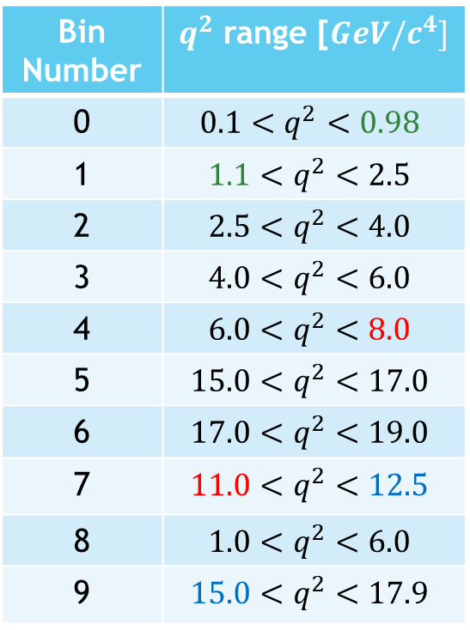

Which $q^{2}$ bins shall we use?
Bin Number | $q^{2}$ range [$GeV/c^{4}]$
0 | $$0.1<q^{2}<0.98$$
1 | $$1.1<q^{2}<2.5$$
2 | $$2.5<q^{2}<4.0$$
3 | $$4.0<q^{2}<6.0$$
4 | $$6.0<q^{2}<8.0$$
5 | $$15.0<q^{2}<17.0$$
6 | $$17.0<q^{2}<19.0$$
7 | $$11.0<q^{2}<12.5$$
8 | $$1.0<q^{2}<6.0$$
9 | $$15.0<q^{2}<17.9$$

Slide 23
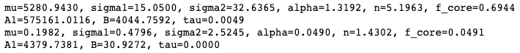
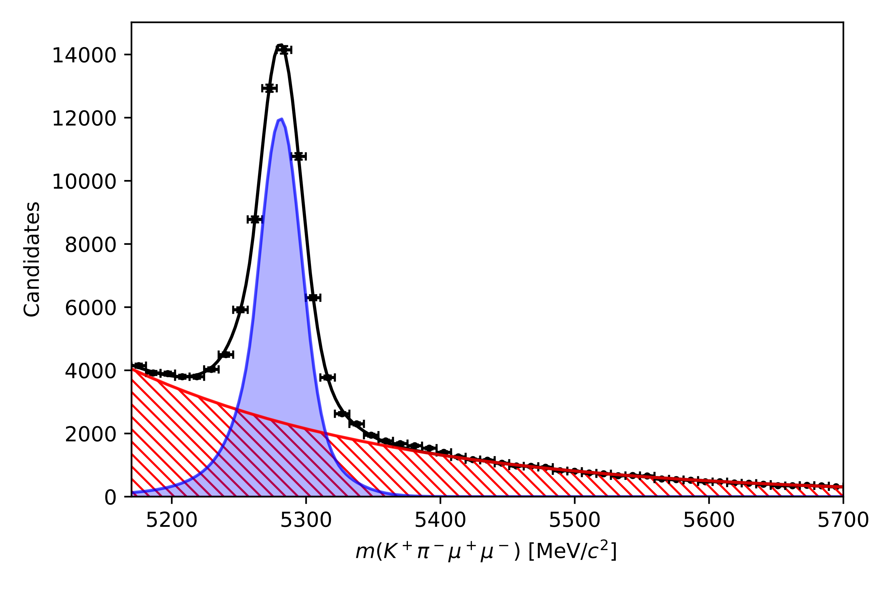
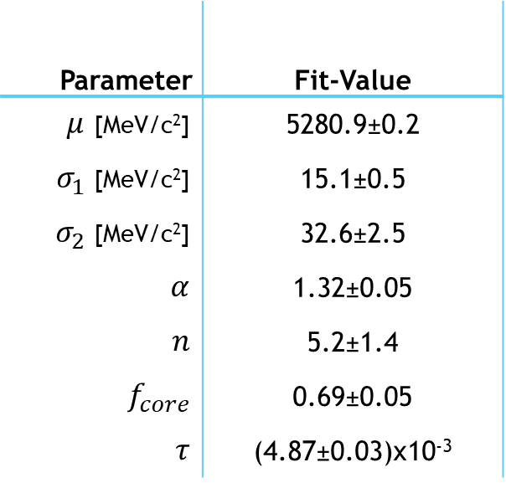
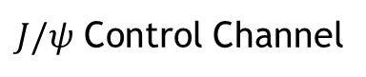
Step 1: Fit to Control Channel
*second row is uncertainties
Parameter | Fit-Value
$μ$ [MeV/c²] | 5280.9±0.2
$σ_{1}$ [MeV/c²] | 15.1±0.5
$σ_{2}$ [MeV/c²] | 32.6±2.5
$α$ | 1.32±0.05
$n$ | 5.2±1.4
$f_{core}$ | 0.69±0.05
$τ$ | (4.87±0.03)x10⁻³
$J/ψ$ Control Channel

Slide 24
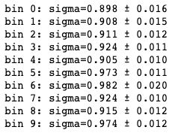
Step 2: Adjust sigma
Bin # | Sigma Scaling
0 | 0.898±0.016
1 | 0.809±0.015
2 | 0.911±0.012
3 | 0.924±0.011
4 | 0.905±0.010
5 | 0.973±0.011
6 | 0.982±0.020
7 | 0.924±0.010
8 | 0.915±0.012
9 | 0.974±0.012

Slide 25
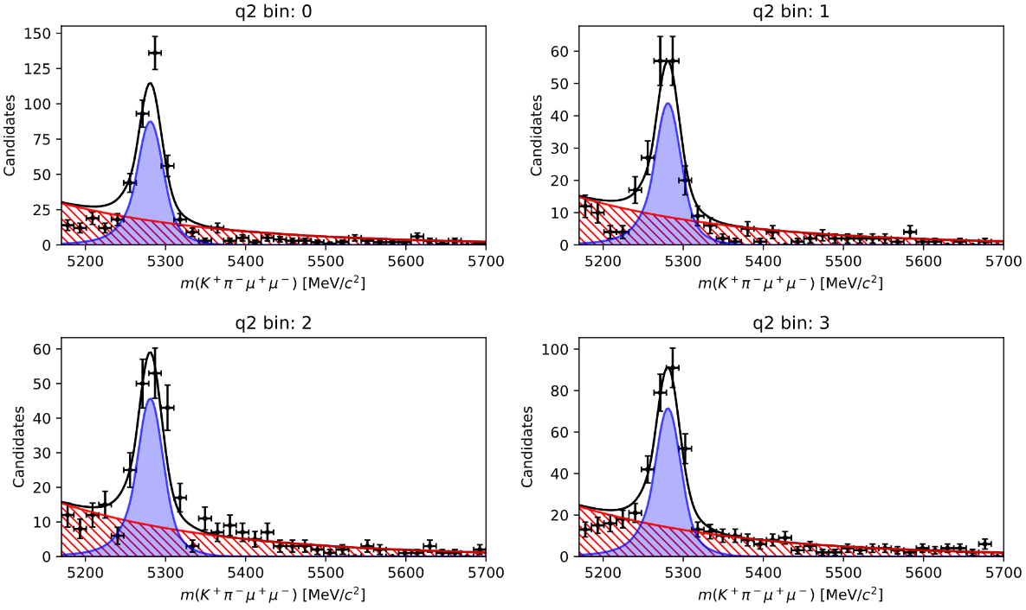
Step 3: Fit to real data

Slide 26
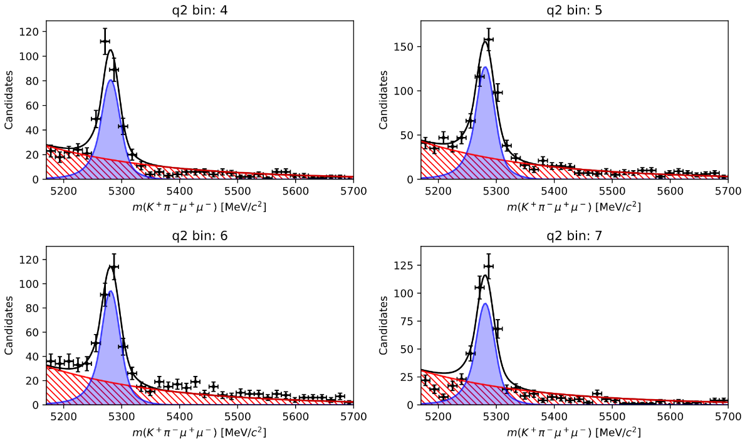
Step 3: Fit to real data

Slide 27
Acceptance

Slide 28
Angular Distribution: Distortion
Angular distribution distorted by three main factors:
The geometry of the detector
Reconstruction of tracks
‘Cherry picking’ of data

Slide 29
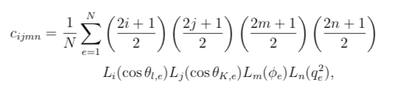
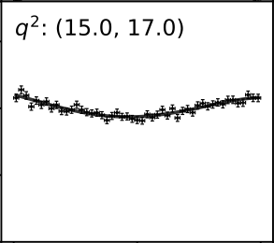
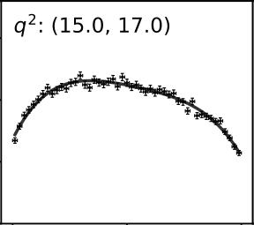
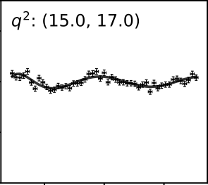

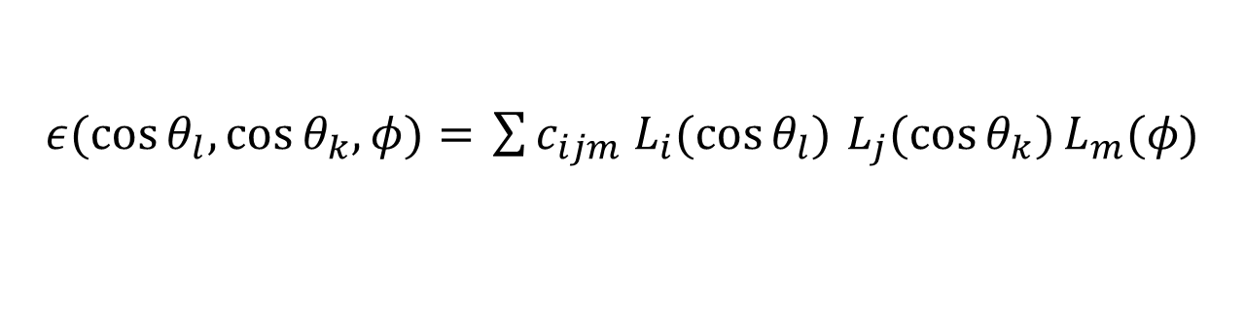

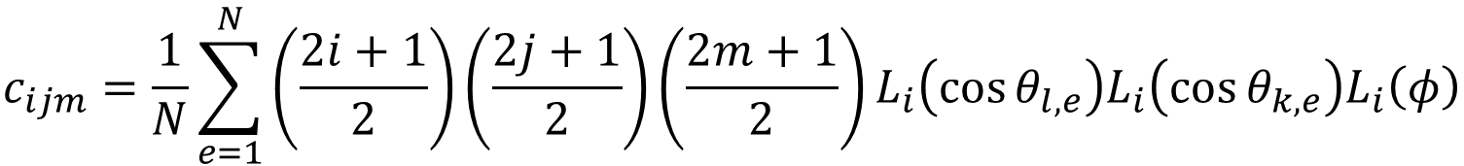
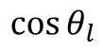
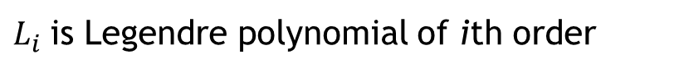
Acceptance Function
$ε(\cos{θ_{l}, \cos{θ_{k}, φ)= }}\sum{c_{ijm} L_{i}(\cos{θ_{l})}}$ $L_{j}(\cos{θ_{k})}L_{m}(φ)$
$$\cos{θ_{l}}$$
$$\cos{θ_{k}}$$
$$φ$$
Up to 4th order
Up to 4th order
Up to 6th order
$$c_{ijm}=\frac{1}{N}\sum_{e=1}^{N}{\left(\frac{2i+1}{2}\right)\left(\frac{2j+1}{2}\right)\left(\frac{2m+1}{2}\right)L_{i}\left(\cos{θ_{l,e}}\right)L_{i}\left(\cos{θ_{k,e}}\right)L_{i}\left(φ\right)}$$
$L_{i}$is Legendre polynomial of ith order

Slide 30
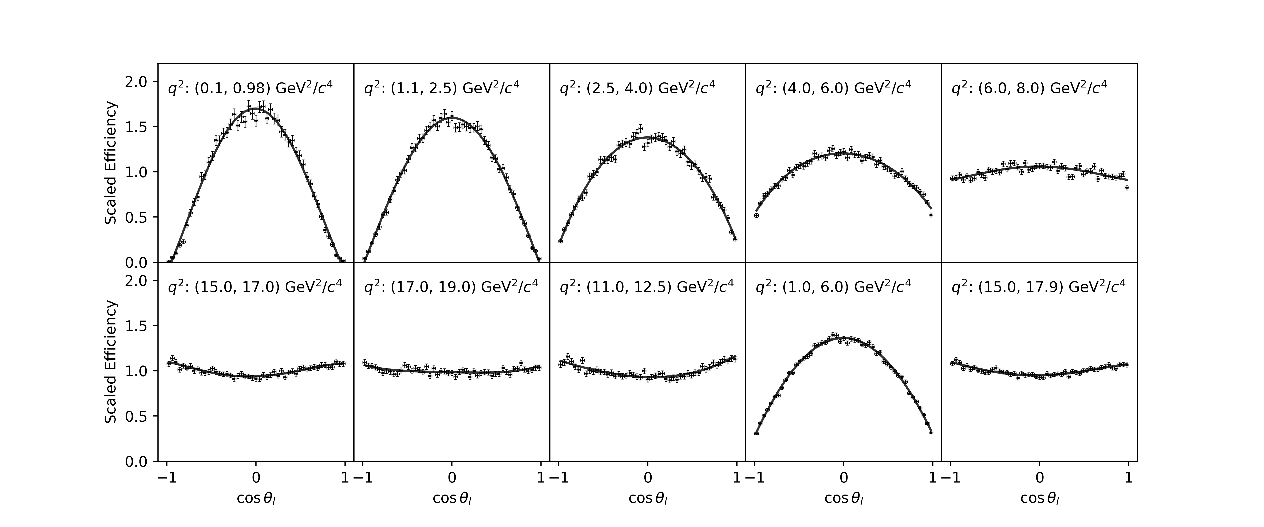

Acceptance Fits - $cosθ_{ℓ}$(Normalised)
Notes:
-

Slide 31
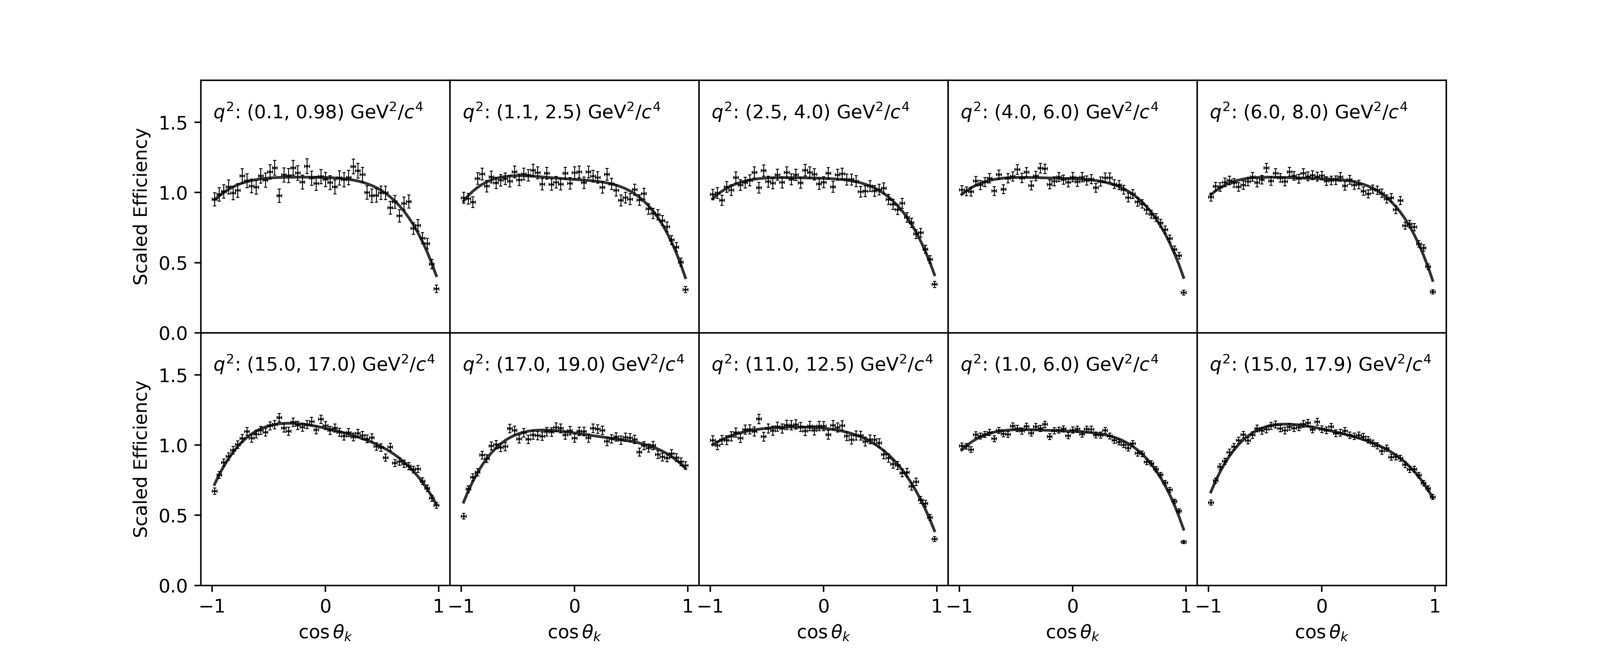

Acceptance Fits - $cosθ_{K}$(Normalised)

Slide 32
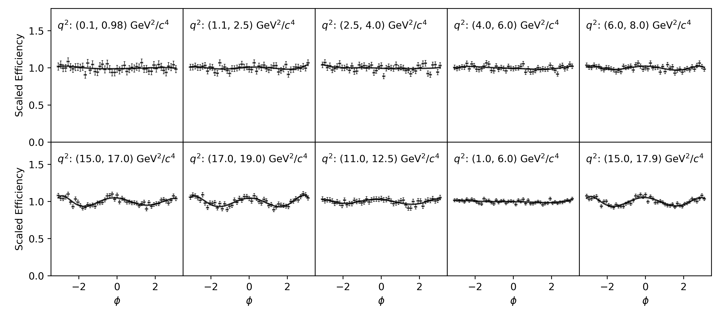

Acceptance Fits - $φ$(Normalised)

Slide 33
Fitting

Slide 34
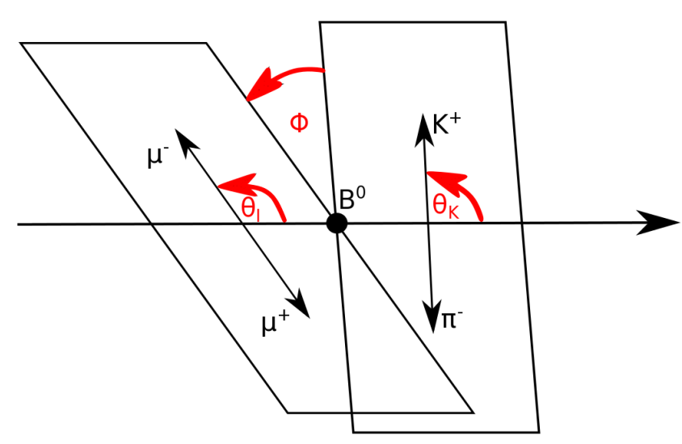


Parameterization of $B^{0}$ Decay
The decay rate of the $B0 → K^{∗}0 μ^{+}μ^{−}$ channel,
as you know, depends on these angles
But HOW?
De Cian M. Track Reconstruction Efficiency and Analysis of $B^{0}→K^{∗0}μ^{+}μ^{−}$ at the LHCb Experiment. 2013, Sep

Slide 35
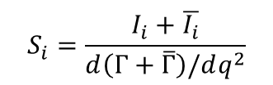
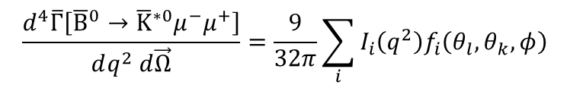
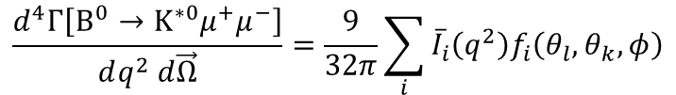
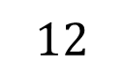
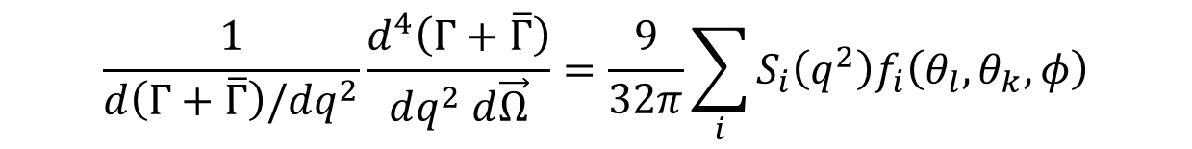
Parameterization of $B^{0}$ Decay
$$\frac{d^{4}Γ\left[B^{0}→K^{∗0}μ^{+}μ^{−}\right]}{dq^{2} d\vec{Ω}}=\frac{9}{32π}\sum_{i}{{\overline{I}}_{i}\left(q^{2}\right)f_{i}\left(θ_{l},θ_{k},φ\right)}$$
$$\frac{d^{4}\overline{Γ}\left[{\overline{B}}^{0}→{\overline{K}}^{∗0}μ^{−}μ^{+}\right]}{dq^{2} d\vec{Ω}}=\frac{9}{32π}\sum_{i}{I_{i}\left(q^{2}\right)f_{i}\left(θ_{l},θ_{k},φ\right)}$$
$$S_{i}=\frac{I_{i}+\overline{I_{i}}}{d\left(Γ+\overline{Γ}\right)/dq^{2}}$$
$$\frac{1}{d\left(Γ+\overline{Γ}\right)/dq^{2}}\frac{d^{4}\left(Γ+\overline{Γ}\right)}{dq^{2} d\vec{Ω}}=\frac{9}{32π}\sum_{i}{S_{i}\left(q^{2}\right)f_{i}\left(θ_{l},θ_{k},φ\right)}$$
$$12$$
[De Cian, 2013]
[Altmannshofer et al, 2009]
[Wehle et al, 2017]

Slide 36







Can we simplify this?
$$8$$
$$12$$
A: YES, assuming massless muons
$S_{6}^{c}$ vanishes
$S_{1}^{s}=3S_{2}^{s}$
$S_{1}^{c}=−S_{2}^{c}$
(from normalisation of dilepton mass distribution)
$$\frac{d\left(Γ+\overline{Γ}\right)}{dq^{2}}=\frac{3}{4}\left(2S_{1}^{s}+S_{1}^{c}\right)−\frac{1}{4}\left(2S_{2}^{s}+S_{2}^{c}\right)=1$$
[Altmannshofer et al, 2009]
[Wehle et al, 2017]

Slide 37


CP – Averaged Distribution
$$\frac{1}{d\left(Γ+\overline{Γ}\right)/dq^{2}}\frac{d^{4}\left(Γ+\overline{Γ}\right)}{dq^{2}d\cos{θ_{𝓁}}d\cos{θ_{K}}dφ}=\frac{9}{32π}\left[\begin{aligned} \\ \end{aligned}\right. \frac{3}{4}\left(1−F_{L}\right)\sin^{2}{θ_{K}}+F_{L}\cos^{2}{θ_{K}}$$
$$+\frac{1}{4}\left(1−F_{L}\right)\sin^{2}{θ_{K}}\cos{2θ_{𝓁}} − F_{L}\cos^{2}{θ_{K}}\cos{2θ_{𝓁}}$$
$$+ S_{3}\sin^{2}{θ_{K}}\sin^{2}{θ_{𝓁}}\cos{2φ}$$
$$+ S_{4}\sin{2θ_{K}\sin{2θ_{𝓁}}}\cos{φ}$$
$$+ S_{5}\sin{2θ_{K}}\sin{θ_{𝓁}}\cos{φ}$$
$$+ S_{6}\sin^{2}{θ_{K}}\cos{θ_{𝓁}}$$
$$+ S_{7}\sin{2θ_{K}}sinθ_{𝓁}\sin{φ}$$
$$+ S_{8}\sin{2θ_{K}}\sin{2θ_{𝓁}}\sin{φ}$$
$$+ S_{9}\sin^{2}{θ_{K}}\sin^{2}{θ_{𝓁}}\sin{2φ}].$$
Where $F_{L}$is the longitudinal polarisation fraction of $K^{∗0}$:
$$F_{L}=S_{1}^{c}=−S_{2}^{c}, \left(1−F_{L}\right)=\frac{4}{3}S_{1}^{s}=4S_{2}^{s}$$
[De Cian, 2013]
[Altmannshofer et al, 2009]
[Wehle et al, 2017]

Slide 38



CP – Averaged Distribution
$$\frac{1}{d\left(Γ+\overline{Γ}\right)/dq^{2}}\frac{d^{4}\left(Γ+\overline{Γ}\right)}{dq^{2}d\cos{θ_{𝓁}}d\cos{θ_{K}}dφ}=\frac{9}{32π}\left[\begin{aligned} \\ \end{aligned}\right. \frac{3}{4}\left(1−F_{L}\right)\sin^{2}{θ_{K}}+F_{L}\cos^{2}{θ_{K}}$$
$$+\frac{1}{4}\left(1−F_{L}\right)\sin^{2}{θ_{K}}\cos{2θ_{𝓁}} − F_{L}\cos^{2}{θ_{K}}\cos{2θ_{𝓁}}$$
$$+ S_{3}\sin^{2}{θ_{K}}\sin^{2}{θ_{𝓁}}\cos{2φ}$$
$$+ S_{4}\sin{2θ_{K}\sin{2θ_{𝓁}}}\cos{φ}$$
$$+ S_{5}\sin{2θ_{K}}\sin{θ_{𝓁}}\cos{φ}$$
$$+ S_{6}\sin^{2}{θ_{K}}\cos{θ_{𝓁}}$$
$$+ S_{7}\sin{2θ_{K}}sinθ_{𝓁}\sin{φ}$$
$$+ S_{8}\sin{2θ_{K}}\sin{2θ_{𝓁}}\sin{φ}$$
$$+ S_{9}\sin^{2}{θ_{K}}\sin^{2}{θ_{𝓁}}\sin{2φ}].$$
Where $F_{L}$is the longitudinal polarisation fraction of $K^{∗0}$:
$$F_{L}=S_{1}^{c}=−S_{2}^{c}, \left(1−F_{L}\right)=\frac{4}{3}S_{1}^{s}=4S_{2}^{s}$$
( )
Frequent in literature are $θ_{l}$forward-backwards asymmetry $A_{FB}$ and transverse polarisation asymmetry $A_{T}^{\left(2\right)}$:
$$A_{FB}=\frac{3}{4}S_{6}, A_{T}^{\left(2\right)}=\frac{{2S}_{3}}{\left(1−F_{L}\right)}$$
[De Cian, 2013]
[Altmannshofer et al, 2009]
[Wehle et al, 2017]

Slide 39

CP – Averaged Distribution
$$\frac{1}{d\left(Γ+\overline{Γ}\right)/dq^{2}}\frac{d^{4}\left(Γ+\overline{Γ}\right)}{dq^{2}d\cos{θ_{𝓁}}d\cos{θ_{K}}dφ}=\frac{9}{32π}\left[\begin{aligned} \\ \end{aligned}\right. \frac{3}{4}\left(1−F_{L}\right)\sin^{2}{θ_{K}}+F_{L}\cos^{2}{θ_{K}}$$
$$+\frac{1}{4}\left(1−F_{L}\right)\sin^{2}{θ_{K}}\cos{2θ_{𝓁}} − F_{L}\cos^{2}{θ_{K}}\cos{2θ_{𝓁}}$$
$$+ S_{3}\sin^{2}{θ_{K}}\sin^{2}{θ_{𝓁}}\cos{2φ}$$
$$+ S_{4}\sin{2θ_{K}\sin{2θ_{𝓁}}}\cos{φ}$$
$$+ S_{5}\sin{2θ_{K}}\sin{θ_{𝓁}}\cos{φ}$$
$$+\frac{4}{3}A_{FB}\sin^{2}{θ_{K}}\cos{θ_{𝓁}}$$
$$+ S_{7}\sin{2θ_{K}}sinθ_{𝓁}\sin{φ}$$
$$+ S_{8}\sin{2θ_{K}}\sin{2θ_{𝓁}}\sin{φ}$$
$$+ S_{9}\sin^{2}{θ_{K}}\sin^{2}{θ_{𝓁}}\sin{2φ}].$$
Where $F_{L}$is the longitudinal polarisation fraction of $K^{∗0}$:
$$F_{L}=S_{1}^{c}=−S_{2}^{c}, \left(1−F_{L}\right)=\frac{4}{3}S_{1}^{s}=4S_{2}^{s}$$
( )
Frequent in literature are $θ_{l}$forward-backwards asymmetry $A_{FB}$ and transverse polarisation asymmetry $A_{T}^{\left(2\right)}$:
$$A_{FB}=\frac{3}{4}S_{6}, A_{T}^{\left(2\right)}=\frac{{2S}_{3}}{\left(1−F_{L}\right)}$$
[De Cian, 2013]
[Altmannshofer et al, 2009]
[Wehle et al, 2017]

Slide 40
















How do we find them?
$$Observables:$$
$$F_{L}$$
$$S_{3}$$
$$S_{4}$$
$$S_{5}$$
$$A_{FB}(S_{6})$$
$$S_{7}$$
$$S_{8}$$
$$S_{9}$$
First, project: integrate, integrate and integrate!
$$\underset{⇒}{over θ_{k} \& φ}$$
$$\frac{1}{Γ+\overline{Γ}}\frac{d^{2}\left(Γ+\overline{Γ}\right)}{dq^{2}d\cos{θ_{𝓁}}}=\frac{3}{4}F_{L}\left(1−\cos^{2}{θ_{𝓁}}\right)+\frac{3}{8}\left(1−F_{L}\right)\left(1+\cos^{2}{θ_{𝓁}}\right)+A_{FB}\cos{θ_{𝓁}}$$
$$\underset{⇒}{over θ_{ℓ} \& φ}$$
$$\frac{1}{Γ+\overline{Γ}}\frac{d^{2}\left(Γ+\overline{Γ}\right)}{dq^{2}d\cos{θ_{K}}}=\frac{3}{2}F_{L}\cos^{2}{θ_{K}}+\frac{3}{4}\left(1−F_{L}\right)\left(1−\cos^{2}{θ_{K}}\right)$$
$$\underset{⇒}{over θ_{ℓ} \& θ_{K}}$$
$$\frac{1}{Γ+\overline{Γ}}\frac{d^{2}\left(Γ+\overline{Γ}\right)}{dq^{2}dφ} = \frac{1}{2π}\left[1+S_{3}\cos{2φ}+S_{9}\sin{2φ}\right]$$
[De Cian, 2013]

Slide 41








$$Observables:$$
$$F_{L}$$
$$S_{3}$$
$$S_{4}$$
$$S_{5}$$
$$A_{FB}(S_{6})$$
$$S_{7}$$
$$S_{8}$$
$$S_{9}$$
Then … fold!
$$\begin{matrix}φ → −φ \\ φ → π−φ \\ θ_{𝓁} → π−θ_{𝓁}\end{matrix} \begin{matrix}if φ<0 \\ if θ_{𝓁}>π/2 \\ if θ_{𝓁}>π/2\end{matrix} ⇒$$
$$\frac{1}{\left(Γ+\overline{Γ}\right)}\frac{d^{4}\left(Γ+\overline{Γ}\right)}{dq^{2}d\cos{θ_{𝓁}}d\cos{θ_{K}}dφ}=\frac{9}{8π}\left[\begin{aligned} \\ \end{aligned}\right. \frac{3}{4}\left(1−F_{L}\right)\sin^{2}{θ_{K}}+F_{L}\cos^{2}{θ_{K}}$$
$$+\frac{1}{4}\left(1−F_{L}\right)\sin^{2}{θ_{K}}\cos{2θ_{𝓁}} − F_{L}\cos^{2}{θ_{K}}\cos{2θ_{𝓁}}$$
$$+ S_{3}\sin^{2}{θ_{K}}\sin^{2}{θ_{𝓁}}\cos{2φ}$$
$$+ S_{4}\sin{2θ_{K}\sin{2θ_{𝓁}}}\cos{φ}]$$
$$\begin{matrix}φ → −φ \\ θ_{𝓁} → π−θ_{𝓁}\end{matrix} \begin{matrix}if φ<0 \\ if θ_{𝓁}>π/2\end{matrix} ⇒$$
$$\frac{1}{\left(Γ+\overline{Γ}\right)}\frac{d^{4}\left(Γ+\overline{Γ}\right)}{dq^{2}d\cos{θ_{𝓁}}d\cos{θ_{K}}dφ}=\frac{9}{8π}\left[\begin{aligned} \\ \end{aligned}\right. \frac{3}{4}\left(1−F_{L}\right)\sin^{2}{θ_{K}}+F_{L}\cos^{2}{θ_{K}}$$
$$+\frac{1}{4}\left(1−F_{L}\right)\sin^{2}{θ_{K}}\cos{2θ_{𝓁}} − F_{L}\cos^{2}{θ_{K}}\cos{2θ_{𝓁}}$$
$$+ S_{3}\sin^{2}{θ_{K}}\sin^{2}{θ_{𝓁}}\cos{2φ}$$
$$+ S_{5}\sin{2θ_{K}\sin{θ_{𝓁}}}\cos{φ}]$$

Slide 42









$$Observables:$$
$$F_{L}$$
$$S_{3}$$
$$S_{4}$$
$$S_{5}$$
$$A_{FB}(S_{6})$$
$$S_{7}$$
$$S_{8}$$
$$S_{9}$$
$$\begin{matrix}φ → −φ \\ φ → −π−φ \\ θ_{𝓁} → π−θ_{𝓁}\end{matrix} \begin{matrix}if φ>π/2 \\ if φ<−π/2 \\ if θ_{𝓁}>π/2\end{matrix} ⇒$$
$$\frac{1}{\left(Γ+\overline{Γ}\right)}\frac{d^{4}\left(Γ+\overline{Γ}\right)}{dq^{2}d\cos{θ_{𝓁}}d\cos{θ_{K}}dφ}=\frac{9}{8π}\left[\begin{aligned} \\ \end{aligned}\right. \frac{3}{4}\left(1−F_{L}\right)\sin^{2}{θ_{K}}+F_{L}\cos^{2}{θ_{K}}$$
$$+\frac{1}{4}\left(1−F_{L}\right)\sin^{2}{θ_{K}}\cos{2θ_{𝓁}} − F_{L}\cos^{2}{θ_{K}}\cos{2θ_{𝓁}}$$
$$+ S_{3}\sin^{2}{θ_{K}}\sin^{2}{θ_{𝓁}}\cos{2φ}$$
$$+ S_{7}\sin{2θ_{K}\sin{θ_{𝓁}}}\sin{φ}]$$
$$\begin{matrix}φ → π−φ \\ φ → −π−φ \\ θ_{𝓁} → π−θ_{𝓁} \\ θ_{K} → π−θ_{K}\end{matrix} \begin{matrix}if φ>π/2 \\ if φ<−π/2 \\ if θ_{𝓁}>π/2 \\ if θ_{𝓁}>π/2 \end{matrix} ⇒$$
$$\frac{1}{\left(Γ+\overline{Γ}\right)}\frac{d^{4}\left(Γ+\overline{Γ}\right)}{dq^{2}d\cos{θ_{𝓁}}d\cos{θ_{K}}dφ}=\frac{9}{8π}\left[\begin{aligned} \\ \end{aligned}\right. \frac{3}{4}\left(1−F_{L}\right)\sin^{2}{θ_{K}}+F_{L}\cos^{2}{θ_{K}}$$
$$+\frac{1}{4}\left(1−F_{L}\right)\sin^{2}{θ_{K}}\cos{2θ_{𝓁}} − F_{L}\cos^{2}{θ_{K}}\cos{2θ_{𝓁}}$$
$$+ S_{3}\sin^{2}{θ_{K}}\sin^{2}{θ_{𝓁}}\cos{2φ}$$
$$+ S_{8}\sin{2θ_{K}\sin{{2θ}_{𝓁}}}\sin{φ}]$$
$$φ → φ+π if φ<0 ⇒$$
$$\frac{1}{\left(Γ+\overline{Γ}\right)}\frac{d^{4}\left(Γ+\overline{Γ}\right)}{dq^{2}d\cos{θ_{𝓁}}d\cos{θ_{K}}dφ}=\frac{9}{16π}\left[\begin{aligned} \\ \end{aligned}\right. \frac{3}{4}\left(1−F_{L}\right)\sin^{2}{θ_{K}}+F_{L}\cos^{2}{θ_{K}}$$
$$+\frac{1}{4}\left(1−F_{L}\right)\sin^{2}{θ_{K}}\cos{2θ_{𝓁}} − F_{L}\cos^{2}{θ_{K}}\cos{2θ_{𝓁}}$$
$$+ S_{3}\sin^{2}{θ_{K}}\sin^{2}{θ_{𝓁}}\cos{2φ}$$
$$+\frac{4}{3}A_{FB}\sin^{2}{θ_{K}}\cos{θ_ℓ}$$
$$+ S_{9}\sin^{2}{θ_{K}\sin^{2}{θ_{𝓁}}}\cos{2φ}]$$

Slide 43





Negative Log Likelihood (NLL) Fit
First, the probability one specific measurement $u_{i}$ was obtained is
$P_{i}\left(u_{i};\vec{p}\right)$
For a whole set of measurements, the product
$$ℒ=\prod{P_{i}}\left(u_{i};\vec{p}\right)$$
Minuit
Take the logarithm, to turn the product into sum:
$$\ln\left(ℒ\right)=\sum{P_{i}}\left(u_{i};\vec{p}\right)$$
Finally, take its opposite, to turn it into a minimisation problem:
$$NLL\left(\vec{p}\right)=−\ln\left(ℒ\right)=−\sum{P_{i}}\left(u_{i};\vec{p}\right)$$
And recall, a $1σ$ uncertainty $Δ\vec{p}$ is such that:
$$NLL\left({\vec{p}}_{min}+Δ\vec{p}\right)=NLL_{min}+0.5$$

Slide 44








Counting Fit
$dΓ$
A completely different approach for some angular observables, known as counting method, predicts that
$$A_{FB}=\left[ \int_{0}^{π/2}{−}\int_{π/2}^{π}{dθ_{𝓁}} \right] \frac{1}{d{\left(Γ+\overline{Γ}\right)}/{dq^{2}}} \frac{d^{4}\left(Γ+\overline{Γ}\right)}{d\vec{Ω} dq^{2}}$$
Wascko M. 2022 Nuclear and Particle Physics.
Imperial College London. Course Notes.
$$S_{4}=\frac{π}{2}\left[ \int_{0}^{π/2}{−}\int_{π/2}^{π}{dθ_{𝓁}} \right]\left[ \int_{0}^{π/2}{−}\int_{π/2}^{π}{dθ_{K}} \right]\left[ −\int_{−π}^{−π/2}{+}\int_{−π/2}^{π/2}{−}\int_{π/2}^{π}{dφ}\right]\frac{1}{d{\left(Γ+\overline{Γ}\right)}/{dq^{2}}}\frac{d^{4}\left(Γ+\overline{Γ}\right)}{d\vec{Ω} dq^{2}}$$
$$S_{5}=\frac{4}{3} \left[ \int_{0}^{π}{dθ_{𝓁}} \right] \left[ \int_{0}^{π/2}{−}\int_{π/2}^{π}{dθ_{K}} \right]\left[ −\int_{−π}^{−π/2}{+}\int_{−π/2}^{π/2}{−}\int_{π/2}^{π}{dφ}\right]\frac{1}{d{\left(Γ+\overline{Γ}\right)}/{dq^{2}}}\frac{d^{4}\left(Γ+\overline{Γ}\right)}{d\vec{Ω} dq^{2}}$$
$$S_{7}=\frac{4}{3} \left[ \int_{0}^{π}{dθ_{𝓁}} \right] \left[ \int_{0}^{π/2}{−}\int_{π/2}^{π}{dθ_{K}} \right] \left[ −\int_{−π}^{0}{+}\int_{0}^{π}{dφ}\right] \frac{1}{d{\left(Γ+\overline{Γ}\right)}/{dq^{2}}}\frac{d^{4}\left(Γ+\overline{Γ}\right)}{d\vec{Ω} dq^{2}}$$
$$S_{8}=\frac{π}{2}\left[ \int_{0}^{π/2}{−}\int_{π/2}^{π}{dθ_{𝓁}} \right]\left[ \int_{0}^{π/2}{−}\int_{π/2}^{π}{dθ_{K}} \right] \left[ −\int_{−π}^{0}{+}\int_{0}^{π}{dφ}\right] \frac{1}{d{\left(Γ+\overline{Γ}\right)}/{dq^{2}}}\frac{d^{4}\left(Γ+\overline{Γ}\right)}{d\vec{Ω} dq^{2}}$$
$$A_{FB}=\frac{A_{FB}^{+}−A_{FB}^{−}}{A_{FB}^{+}+A_{FB}^{−}},$$
$$S_{4}=\frac{π}{2}\frac{S_{4}^{+}−S_{4}^{−}}{S_{4}^{+}+S_{4}^{−}},$$
$$S_{5}=\frac{4}{3}\frac{S_{5}^{+}−S_{5}^{−}}{S_{5}^{+}+S_{5}^{−}},$$
$$S_{7}=\frac{4}{3}\frac{S_{7}^{+}−S_{7}^{−}}{S_{7}^{+}+S_{7}^{−}},$$
$$S_{8}=\frac{π}{2}\frac{S_{8}^{+}−S_{8}^{−}}{S_{8}^{+}+S_{8}^{−}}$$
[Lionetto, 2016]

Slide 45





Testing Toy Data – ${NLL}_{θ_{ℓ}}$
Let’s look at the outcasts:
Bin 4
Bin 6

Slide 46


Testing Toy Data – Counting
Counting, $1σ \sim \sqrt{n}$ , then, when normalising:
$$1σ_{norm}\sim \frac{\sqrt{n}}{n}\sim \frac{1}{\sqrt{n}}$$

Slide 47
Uncertainties & Results

Slide 48
Total uncertainty is given by…
2
2
Total Uncertainty
Statistical Uncertainties
Systematic Uncertainties
Recall:
Likelihood: 0.5 variation in NLL (Minuit)
Counting : square root of height of histogram bins
See next two slides…

Slide 49



Classification$→$Fit Propagation
The following method accounts for how ‘sensitive’ the fit is to small variations in the classified dataset
Run these datasets through the fit to get the $S_{i}, A_{fb} and F_{l}$for each data set…
→ Classification → fit propogation taken as standard deviation
Create 40 ‘variations’ of the original classified data set by cutting different events based on $P_{sig}$
$$P_{sig}=\frac{N_{sig}}{N_{sig}+N_{background}}$$

Slide 50



Acceptance $→$Fit Propagation
Similarly, the sensitivity of the fit to variations in the acceptance function coefficients was calculated using the following method
The ‘varied’ acceptance functions were utilized in runs of the fit to get $S_{i}, A_{fb} and F_{l}$…
→ Acceptance to fit propagation error is standard deviation
Acceptance functions
Coefficients are varied randomly 10 times in range of $c_{ijm}±σ_{ijm}$

Slide 51



Projections: $\cos{θ_{ℓ}}$

Slide 52



Projections: $\cos{θ_{K}}$

Slide 53



Projections: $φ$

Slide 54


$F_{l},A_{fb}$and $S_{i}$ observables

Slide 55

Final Fit

Slide 56


$P_{i}$ Parameters
$$P_{1}=\frac{2S_{3}}{1−F_{L}}=A_{T}^{\left(2\right)}, P_{2}=\frac{2}{3}\frac{A_{FB}}{1−F_{L}}, P_{3}=−\frac{S_{9}}{1−F_{L}}, P_{i=4,5,6,8}^{′}=\frac{S_{j=4,5, 7,8}}{\sqrt{F_{L}\left(1−F_{L}\right)}}$$
[De Cian, 2013]
[Wehle et al, 2017]

Slide 57






Z-Score of Parameters
Z-score of $S_{i}$
Z-score of $P_{i}$
$$\frac{\left|x_{fit}−x_{SM}\right|}{\sqrt{σ_{fit}^{2}+σ_{SM}^{2}}}$$
$$\frac{\left|x_{fit}−x_{SM}\right|}{\sqrt{σ_{fit}^{2}+σ_{SM}^{2}}}$$

Slide 58


Conclusions
Our work involved:
Classification of data:
Calculation of acceptance function $ε(\cos{θ_{l}},\cos{θ_{K}}, φ$)
Fit (NLL and Counting)
Propagation of Uncertainty
Main Observations:
$F_{l},A_{fb}, S_{3}$: present general agreement with theory, yet with occasional deviations
$S_{4}$: General Agreement
$S_{5}$: Poor Agreement
$S_{7,}S_{8},S_{9}$: Good agreement (with large error bars)
Hard cuts
Decision boosting trees
Crystal ball mass fit

Slide 59

References
The LHCb Collaboration. Angular analysis of the B0 to K*0 μ+ μ- decay using 3 fb-1 of integrated luminosity. Journal of High Energy Physics, Vol. 104, 2016.
T. CMS and L. collaborations. Observation of the rare Bs0 → μ+ μ- decay from the combined analysis of CMS and LHCb data. Nature, vol. 522, pp. 68–72, 2015.
Aaij R, C. Abellan Beteta, A. Adametz,et al. Evidence for the decay B0→J/ψω and measurement of the relative branching fractions of Bs0 meson decays to J/ψη and J/ψη′, Nuclear Physics B, Volume 867, Issue 3, 2013, pp. 547-566, ISSN 0550-3213, https://doi.org/10.1016/j.nuclphysb.2012.10.021
Aaij R, et al. LHCb collaboration. Differential branching fraction and angular analysis of the decay B0→ K∗0µ+µ−. Available at https://arxiv.org/abs/1304.6325.
Altmannshofer W, et al. Symmetries and Asymmetries of B → K∗µ +µ − Decays in the Standard Model and Beyond, JHEP 0901 (2009) 019. Available at https://arxiv.org/pdf/0811.1214.pdf.
De Cian M. Track Reconstruction Efficiency and Analysis of $B^{0}→K^{∗0}μ^{+}μ^{−}$ at the LHCb Experiment. 2013, Sep. Available at https://cds.cern.ch/record/1605179.
Kress F. Angular analysis of the B0 to K*0 μ+ μ- decay at the LHCb experiment. PhD Thesis. Imperial College London, 2020.
Lionetto F. Measurements of Angular Oservables of $B^{0}→K^{∗0}μ^{+}μ^{−}$ and $B^{0}→K^{∗0}e^{+}e^{−}$ Decays and the Upgrade of LHCb. 2018, Feb. Available at https://cds.cern.ch/record/2624938. (Pages 94-96)
Wehle S, et al. Lepton-flavor-dependent angular analysis of B → K∗ ` +` −, Phys. Rev. Lett. 118 (2017) 111801, arXiv:1612.05014. Available at https://journals.aps.org/prl/abstract/10.1103/PhysRevLett.118.111801.

Slide 60
Our Team
Alexander Morton-Cooper
Andres Perez Fadon
Angus Grierson
Autumn Wayland
Dilraj Sidhu
Fei Fang
Hussein Diab
Jacopo Uggeri
Jonathan Han
Joseph Canavan
Movindu Dassanayake
Riccardo Nori
Sabrina Perrenoud
Shi Wei Yuan
Sophie Lee-Hoareau
Stefano Veroni
Tamara Anand
Umar Mahmood
Vaisaaly Varatharajan
Vania Lay
Yuchen Kang
Zhenghe Xuan
Zhihao Zhang

Slide 61

Appendix: Numerical Results

Slide 62


Slide 63


Slide 64


Slide 65


Slide 66
Thanks for listening. We shall now answer your questions.

